Slide 1

Parkinson’s Disease Detection Using Machine Learning
By: Rahul Khanna

Slide 2

Problem Statement
Parkinson's disease is a progressive neurodegenerative disorder that primarily affects movement but also impairs speech, writing, and facial expressions. It is estimated to affect more than 10 million people worldwide, with incidence rates increasing with age. Early symptoms often manifest subtly through changes in speech patterns, such as reduced volume, slurring, or a monotonous tone.
Timely and accurate diagnosis is critical, as early interventions can significantly improve quality of life and slow disease progression. However, traditional clinical diagnosis heavily relies on subjective assessments by specialists, which may lead to delayed recognition of early-stage symptoms.
This project aims to leverage structured speech signal data to develop machine learning and deep learning models capable of detecting Parkinson's disease with high sensitivity and specificity. By analyzing vocal biomarkers using techniques like Random Forests and Deep Neural Networks, the objective is to build, evaluate, and fine-tune predictive models that can support clinicians in early diagnosis.

Slide 3
Goals
Build and compare multiple models to detect Parkinson's disease.
Maximize recall (sensitivity) to prioritize minimizing false negatives in a healthcare setting.
Achieve high ROC AUC scores to ensure robust model performance.
Support future deployment in clinical or telemedicine environments for early screening.

Slide 4
Dataset Overview
Dataset Overview
The dataset used for this project is sourced from Kaggle's "Parkinson's Speech Signal Features" collection.
It contains detailed speech recordings captured from individuals diagnosed with Parkinson’s disease as well as healthy controls.
Key Characteristics:
Total Samples: 756 observations
Features: 753 speech-related attributes extracted from voice recordings, including frequency, jitter, shimmer, and various transformed wavelet coefficients.
Target Variable: class
0 – Healthy individuals
1 – Individuals diagnosed with Parkinson's disease
Data Preprocessing Performed:
ID Column Removed: The non-informative 'id' field was dropped.
Feature Scaling: All numerical features were standardized using StandardScaler to ensure consistent input ranges for Machine Learning and Deep Learning models.
Train-Test Split: The dataset was divided into 80% training and 20% testing sets using stratified sampling to maintain the proportion of Parkinson's and Healthy cases across splits.
This structured preparation ensures that models are trained efficiently and are evaluated fairly on unseen data.

Slide 5
Exploratory Data Analysis
Class distribution shows an imbalance (more Parkinson's cases).
Feature distributions visualized.
Correlation matrix plotted for feature relationships.

Slide 6
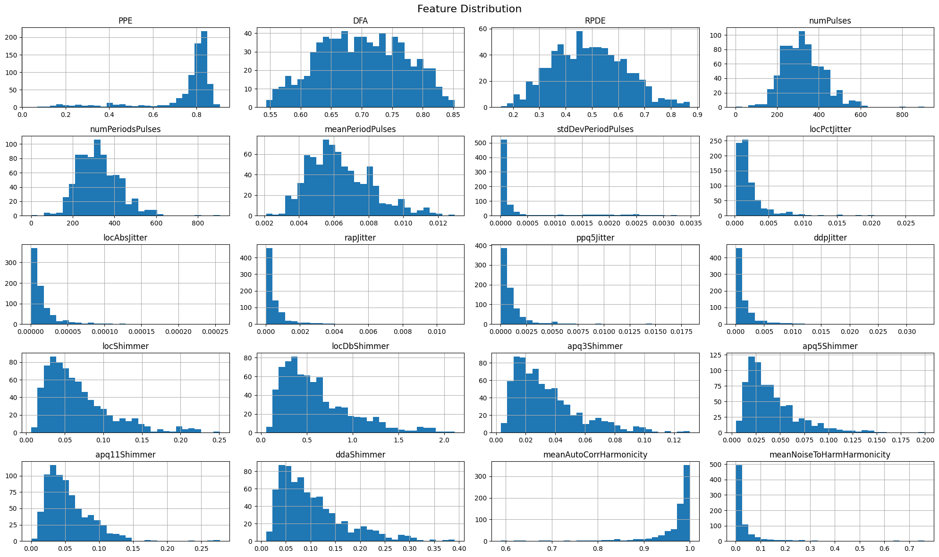

Slide 7
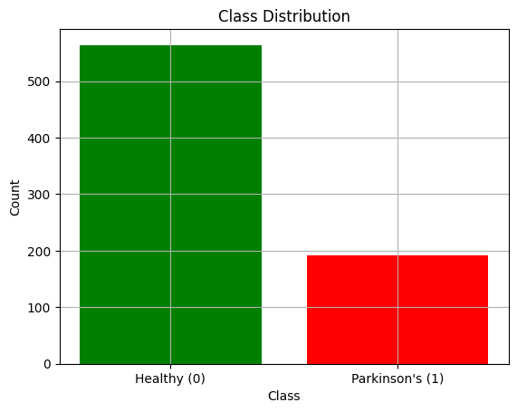
Class Distribution

Slide 8
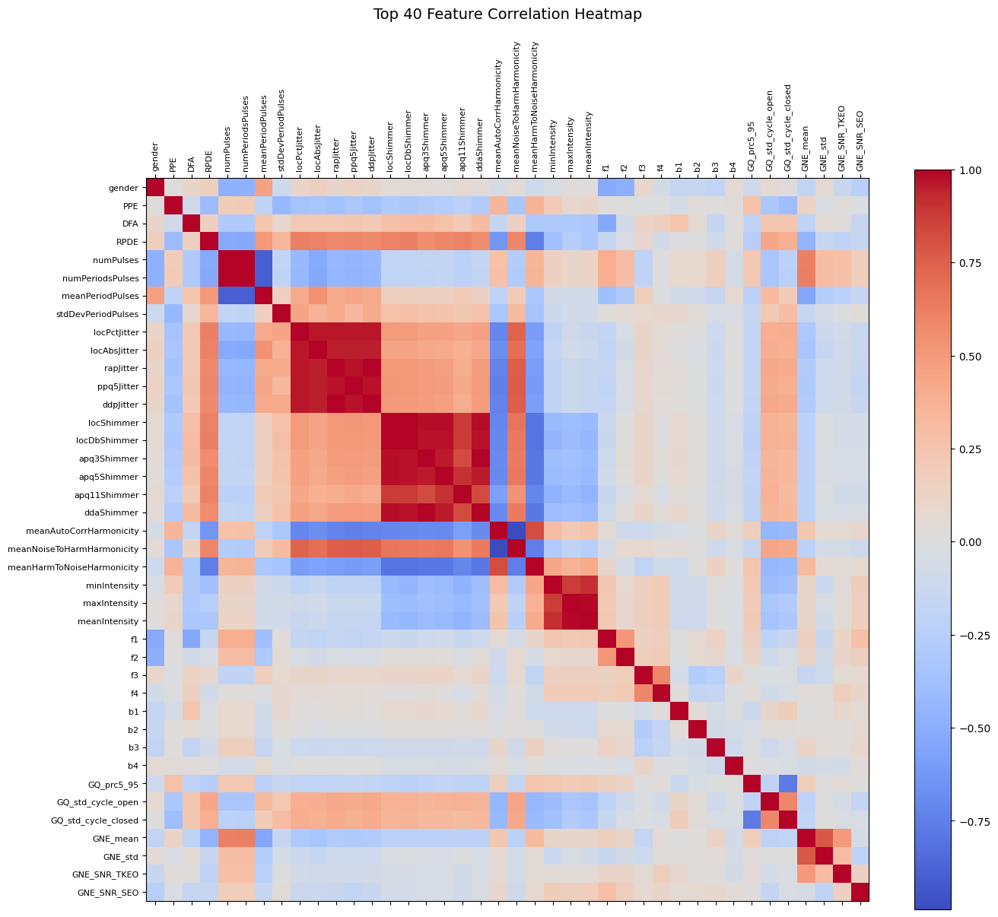
Notes:
Helps spot highly correlated features (which can sometimes be dropped or combined later)
Helps detect redundancy in the data
Provides intuition on feature relationships that might impact the models
"The heatmap shows how strongly each feature is correlated with every other feature, helping identify relationships, redundancies, and guiding feature selection.“
The correlation heatmap revealed several groups of strongly correlated features, indicating potential redundancy. While no aggressive feature dropping was performed for this project to preserve all information, the insight suggests that future work could explore feature selection techniques like Principal Component Analysis (PCA) or recursive feature elimination to further optimize model performance and efficiency

Slide 9
Machine Learning Models
Model | Accuracy | Precision (Class 1) | Recall (Class 1) | F1-Score (Class 1) | ROC AUC
Logistic Regression | 84% | 0.89 | 0.9 | 0.89 | 0.846
Random Forest (baseline) | 85% | 0.85 | 0.96 | 0.9 | 0.932
Support Vector Machine (SVM) | 84% | 0.88 | 0.9 | 0.89 | 0.885
- **Random Forest** initially outperformed other models, achieving the highest Recall and ROC AUC.
- These metrics guided model selection for further fine-tuning.
Notes:
Random Forest performed best (initial ROC AUC: 0.932).

Slide 10
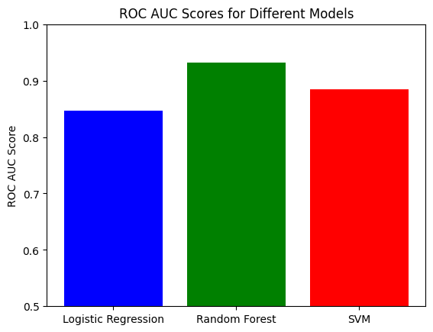
ROC Scores
Notes:
Highest Recall (0.96) → critical for Parkinson’s detection
Highest ROC AUC (0.932) → shows strongest class separability
Good Precision, F1-Score, and overall Accuracy

Slide 11
Deep Learning Model (Neural Network)
3 Dense layers with Dropout
EarlyStopping and ReduceLROnPlateau callbacks used
Training/validation curves plotted
Test evaluation showed:
Accuracy: 83%
ROC AUC: 0.868

Slide 12
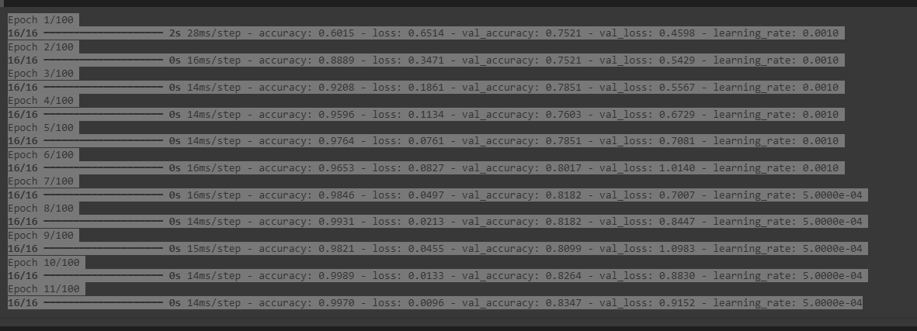
Epoch

Slide 13
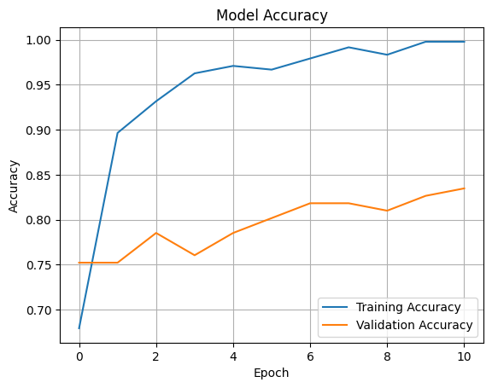
Model Accuracy

Slide 14
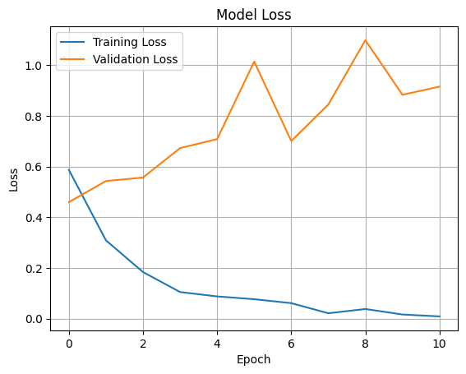
Model Loss

Slide 15
Classification Report – Neural Network
Class Label | Precision | Recall | F1-Score | Support
0 (Healthy) | 0.69 | 0.62 | 0.65 | 39
1 (Parkinson’s) | 0.87 | 0.9 | 0.89 | 113
Metric | Value
Accuracy | 83%
Macro Avg F1 | 77%
Weighted Avg F1 | 83%
ROC AUC Score | 0.868
Notes:
Neural Network achieved good generalization but Random Forest performed better in recall and ROC AUC.

Slide 16
Model Selection Rationale
Metric | Random Forest | Neural Network
Accuracy | 85% | 83%
Recall (Class 1) | 96% | 90%
ROC AUC Score | 0.924 | 0.868
Recall Priority: Detecting Parkinson's disease cases (Class 1) is crucial. Random Forest achieved a recall of 96% compared to 90% for the Neural Network.
Higher ROC AUC: Random Forest achieved a superior ROC AUC, indicating better class separability.
Consistency and Simplicity: Random Forest was simpler to tune and demonstrated less variance between validation and test performance.
Notes:
Metrics comparison
Clinical relevance (recall priority)
Model simplicity

Slide 17
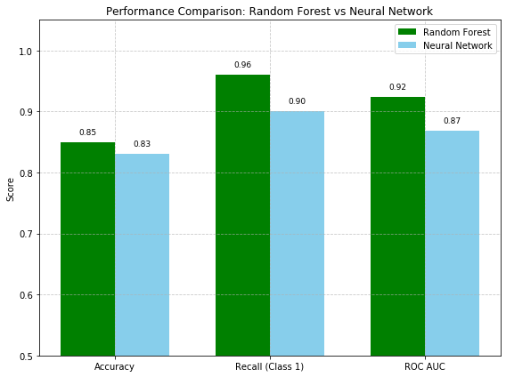
Performance Comparision:

Slide 18
Final Model Selection
Parameter | Range Explored | Value Selected
n_estimators | [100, 200] | 100
max_depth | [10, 20, None] | 20
min_samples_split | [2, 5] | 2
min_samples_leaf | [1, 2] | 1
max_features | ['sqrt', None] | 'sqrt'
Why Hyperparameter Optimization?
Hyperparameter tuning allows us to enhance model performance by finding the optimal settings for key parameters, ensuring the model generalizes better and reduces overfitting. For Random Forests, tuning is particularly important to balance bias and variance.
Why RandomizedSearchCV?
Efficiency: RandomizedSearchCV samples a subset of parameter combinations rather than trying all possibilities (like GridSearchCV), significantly reducing computation time.
Flexibility: Enables quick exploration of a wide range of hyperparameter values.
Performance-Oriented: Focused on maximizing ROC AUC to ensure the model’s robustness in class separation.
Notes:
Outcomes Achieved:
ROC AUC Improved: Achieved a strong ROC AUC score of 0.924 after tuning.
High Recall: Maintained a recall of 96% for Parkinson’s detection, which is critical in minimizing false negatives.
Stable and Reliable Model: Fine-tuning led to better consistency between training and validation, ensuring robustness without overfitting.
By applying RandomizedSearchCV for hyperparameter tuning, the Random Forest model was optimized to achieve a balance between performance and efficiency, making it the best candidate for early detection of Parkinson’s disease.

Slide 19
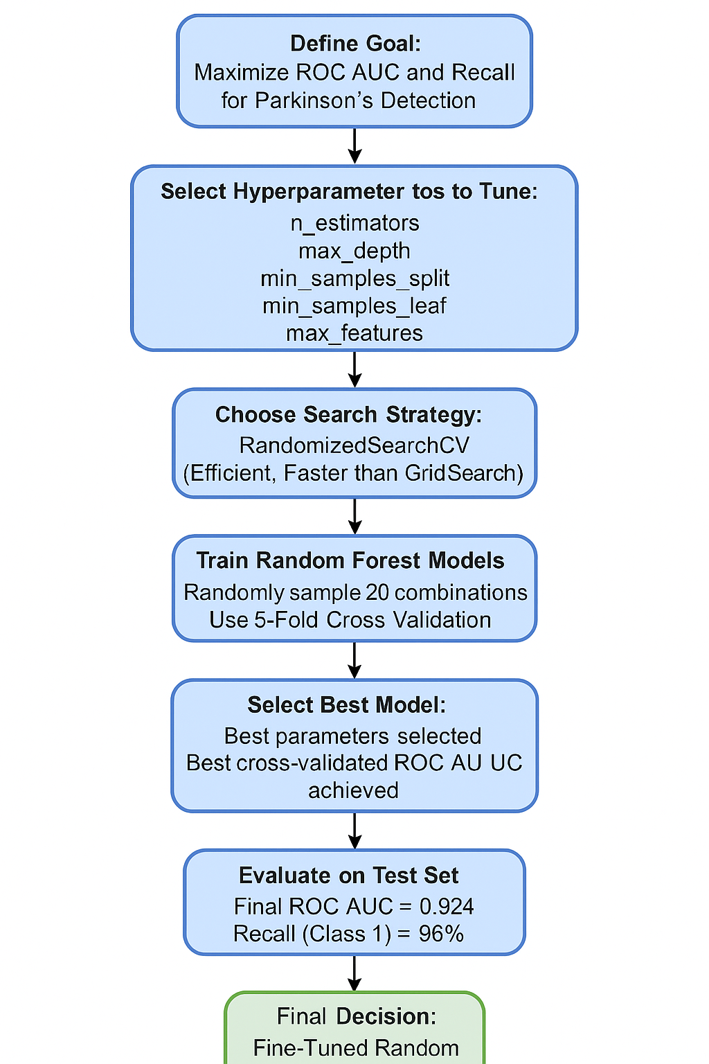

Slide 20
Conclusion
This project successfully demonstrated the complete end-to-end development of predictive models for early Parkinson's disease detection using speech signal features.
Inclusions:
End-to-End Pipeline: Successfully handled data preprocessing, exploratory analysis, model building, evaluation, and fine-tuning.
Model Selection: Fine-tuned Random Forest was selected as the final model based on superior clinical performance.
Performance: Achieved an impressive ROC AUC score of 0.924 and a 96% recall rate, emphasizing the model's strong ability to detect Parkinson's cases early.
Clinical Relevance: Focused on minimizing false negatives, ensuring model readiness for healthcare deployment.
Hyperparameter Tuning: Highlighted the critical role of optimization in boosting model robustness and reliability.

Slide 21
Future Scope
Feature Engineering and Dimensionality Reduction: Apply Principal Component Analysis (PCA) or advanced feature selection techniques to reduce redundancy and potentially enhance model efficiency.
Advanced Ensemble Techniques: Explore stacking or blending models, combining strengths of Random Forests and Neural Networks to further boost predictive performance.
Deep Learning Enhancements: Refine the Neural Network architecture with techniques like batch normalization, learning rate schedulers, and dropout optimization.
Deployment Readiness: Package the final model with a web-based application for real-world clinical screening.
Dataset Expansion: Validate the model on larger, multi-source clinical datasets to enhance generalizability and robustness

Slide 22
Git Hub URL

